Slide 1
More with Classes:
Inheritance
Creative Commons Attribution-NonCommercial-ShareAlike 3.0 Unported License. http://creativecommons.org/licenses/by-nc-sa/3.0/
Written by Rachel J. Morris, last updated 2016-02-14

Slide 2

Reusing Functionality

Slide 3
Reusing Functionality
The idea behind inheritance is that it is a way to re-use code.
A lot of design we do in software development is for the sake of not duplicating code, if you think about it.
Let's say we have several classes with functionality that is common between them, but they're also different enough to need their own unique functions.
We could move those shared functions and variables into a single class, the parent class, and these classes now inherit the shared functionality from the parent.
Now these classes are child classes, and their unique functionality is seen as “specialization”, on top of the shared functionality they all have.

Slide 4



Reusing Functionality
For example, let's say that we're designing a user interface. What objects would we need?
Button
Some of these might have text in common, or they would have a behavior that is run when clicked.
Label
Some of these might contain other classes. For example, a List object might contain an array of Labels.
Link
Image
All of these need functionality that Draw them to the screen.
Checkbox
List
Sometimes, you'll see a generic
User Interface object called a Widget.

Slide 5
Reusing Functionality
Widget
Draw
Clickable
OnClick()
Label
Text
List
LabelArray
Image
ImageURL
Button
Border
Color
Label
Checkbox
IsChecked
Label
Link
LinkURL
A widget family might look something like this – A series of parents and children, through inheritance.
Widget would be the great grandparent that every other
User Interface object would eventually be derived from.

Slide 6
Reusing Functionality
List
Labels[100]
Label
Text
ImageButton
Image
Button
Image
ImageURL
Button
Border
Color
Label
Label
Text
Then you could expand more, by having classes contain others...
Button contains a Label,
and an ImageButton contains an Image and a Button.

Slide 7
Inheritance in the Code

Slide 8
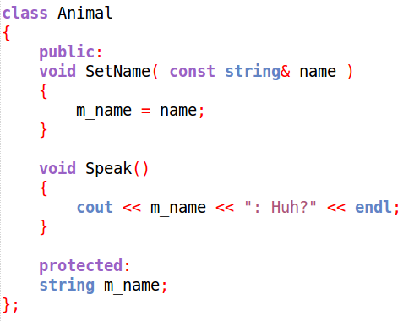
Inheritance in the Code
First, we need to create a base class, which is just a normal class.
When using inheritance, any member variables that you want the child classes to use, should be set as protected, instead of private. More on this later.

Slide 9
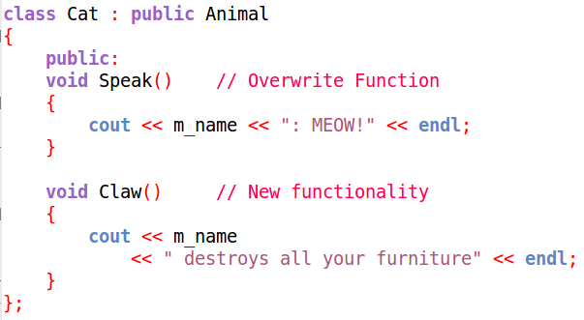
Inheritance in the Code
Then, to have another class inherit, you declare the class and put
: public PARENTCLASSNAME
on the same line as the class

Slide 10
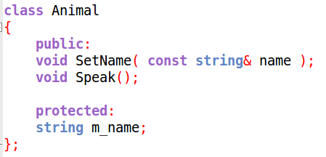
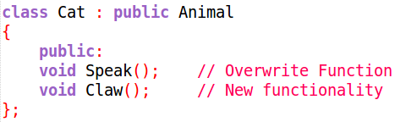
Inheritance in the Code
Now our child class will have:
Functionality inherited from the parent –
SetName(...)
Functionality from the parent that it is overwriting –
Speak()
Its own unique functionality – Claw()
Even though we don't see
void SetName(...)
In the Cat class declaration,
Because it was public in the parent class, it is automatically a part of this new class.

Slide 11
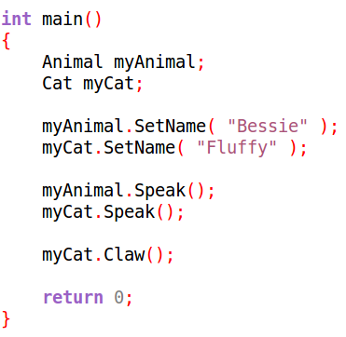
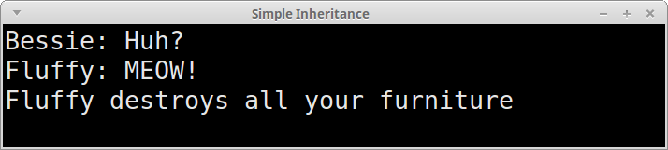
Inheritance in the Code
Now we can declare classes of either type, and utilize its shared functions in the same way.
Only the child can use functions that were uniquely declared within the child class.
shared
overwritten
unique to Cat

Slide 12
Inheritance in the Code
But what is this “protected” stuff?

Slide 13
Public, Private, & Protected

Slide 14
Public, Private, & Protected
We didn't need the protected keyword before, without inheritance.
We were only using public and private to restrict access to certain parts of our classes.
If you set a member variable or function to private,
then any child classes cannot access those private members.
However, if you set a member variable or function to protected, it is still treating it like a private member (nothing outside the class can access it).
However when you have a child class, it also becomes a protected member of the child class – so, private to any non-family,
but available to descendants.
There might be times when you do not want functionality to be shared with child classes,
so using private here would be appropriate.

Slide 15
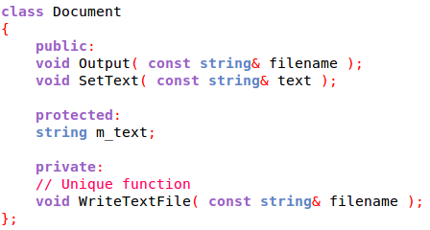
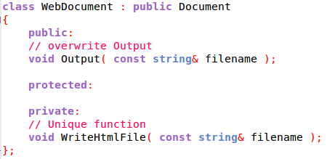
Public, Private, & Protected
Here, we have two Document classes – one saves plaintext (.txt), and the other saves a web (.html) document.
Therefore, they both have private functions for
WriteTextFile and WriteHtmlFile.
These aren't shared, and are unique to each class.
Instead, they have a shared Output function,
which takes in the file name, then calls the Write function.

Slide 16
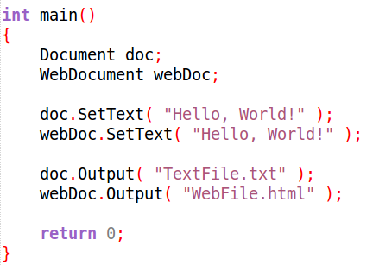
Public, Private, & Protected
To the user / other programmers, they have the same interface, but behind-the-scenes, they work differently.

Slide 17
Function Redefining
and Function Overloading

Slide 18
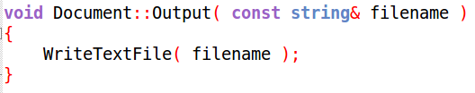
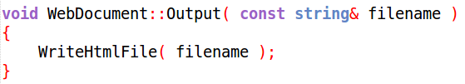
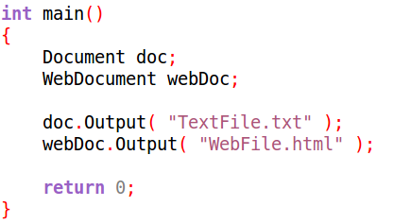
Redefine & Overload
We have had examples of overwriting (or redefining) member functions.
This is when, in our child class, we redeclare a function that the parent has. The redeclaration has the same
return type, name, and parameter list.
This isn't the same as function overloading.
The function is called in the same way, but will go to the special child version instead of the parent version.

Slide 19
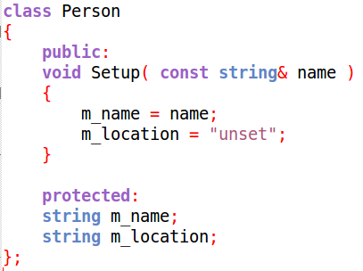
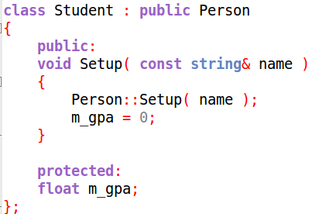
Redefine & Overload
Even if we redeclare a function, we can still call the parents' version.
We might do this if the new function expands on top of the old functionality, and we don't want to duplicate the old code.
The parent version of Setup works just fine, we just need to add some more initialization afterwards, so call the parent.

Slide 20
Redefine & Overload
To call the parents' version of the function from within the overwritten / redefined function, use the parent class name, followed by the scope resolution operator :: , and then the function name with any arguments needed.

Slide 21
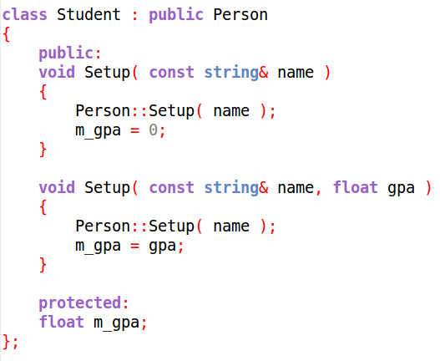
Redefine & Overload
We could also overload parent functions.
Remember that overloading is using the same function name,
but a different parameter list.
overwritten/
redefined
overloaded
We can also still call a parent function as-needed.

Slide 22
More Constructors

Slide 23
Constructors & Inheritance
Similar to calling the base class' functions, we can also call the base class' constructor.
However, to call a parent constructor,
we must do so through the
initializer list.
An initializer list is another way to initialize member variables in a class, rather than manually setting everything within the constructor body.

Slide 24
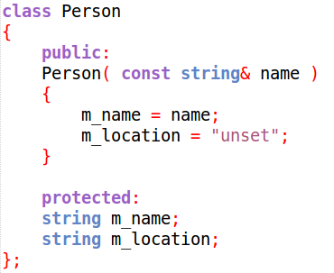
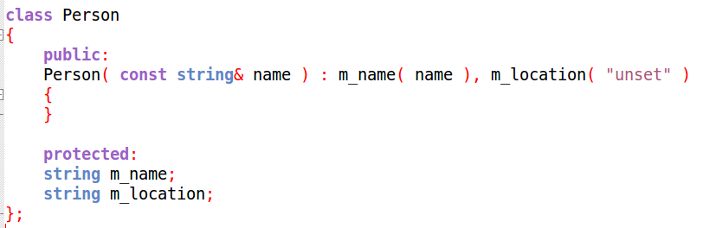
Constructors & Inheritance
No
initializer list
With
initializer list

Slide 25

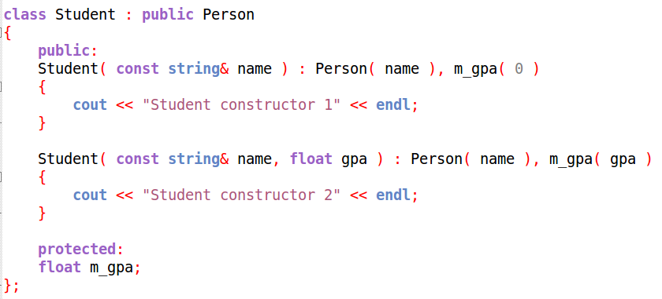
Constructors & Inheritance
In order to call a parent constructor, we need to do so within an
initializer list, like the following:

Slide 26
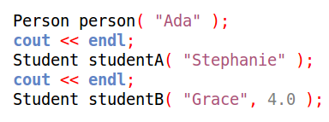
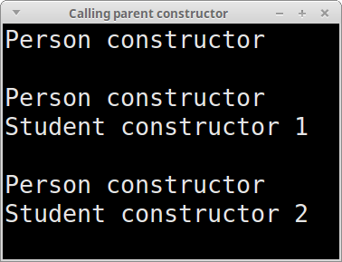
Constructors & Inheritance
Then, when we create instances of our classes:
Notice that the parent constructor will be called first, before the student constructor.

Slide 27
Additional Notes

Slide 28
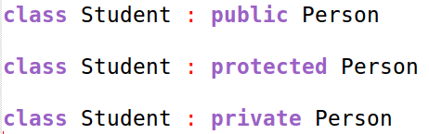
: public BaseClass
You might have noticed that we use the public keyword when we are
inheriting from another class, but what happens if we use protected or private?
For the most part, you will be using
public inheritance.
With private inheritance,
any public or protected members of the parent class now
become private members of the child class.
With protected inheritance,
any public or protected members of the parent class now
become protected members of the child class.
These are used for more advanced design, so don't worry about it.

Slide 29
Multiple Inheritance
Classes can also inherit from multiple parent classes.
Let's say that we have a “Button” class and an “Image” class,
we could use the functionality and variables from both classes
to make an “ImageButton” class, by inheriting from both.
Any protected and public members from both classes now become
protected / public members of the child class, merging the two parents.

Slide 30
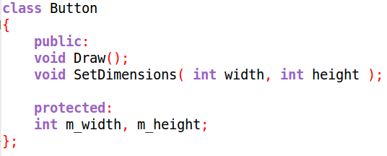
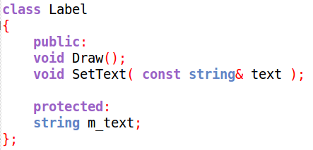
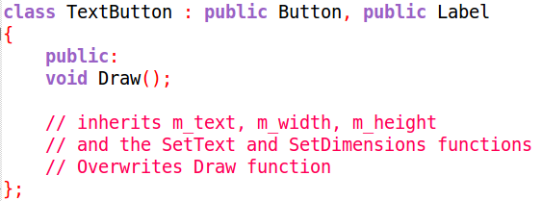
Multiple Inheritance
Now the child class will have any non-private members of both of its parents.

Slide 31
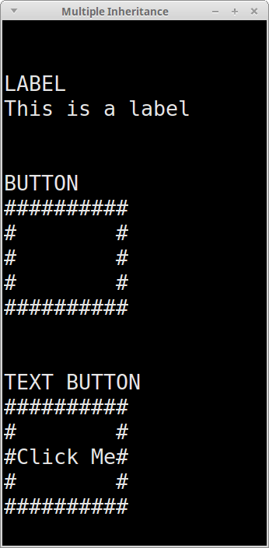
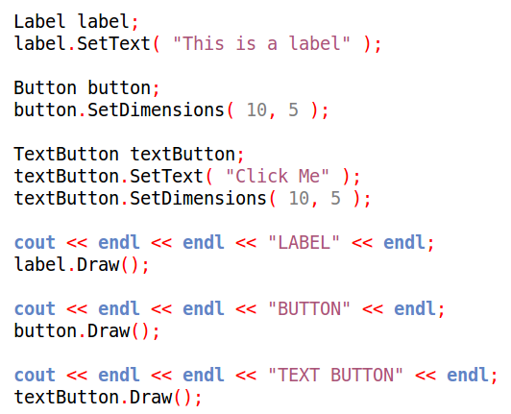
Voilà!
But, inheriting from too many parents can cause the internal code to become messy, rather than concise and compartmentalized...

Slide 32
Is-A, Has-A
Utilizing inheritance is usually considered an “Is-A” relationship.
This means that, if TextButton inherits from Label and Button,
what we're saying is that
“TextButton Is A Label and Is A Button”.
There's another design style that is considered a “Has-A” relationship: Composition.

Slide 33
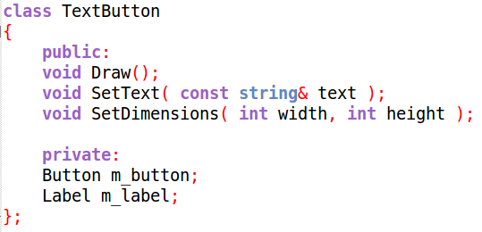
Is-A, Has-A
Utilizing composition is essentially making one class a member of another class,
rather than a parent or child.
INHERITANCE:
IS-A
The TextButton is a child of both the Button and Label classes.
COMPOSITION:
HAS-A
The TextButton contains Button and Label as members.

Slide 34
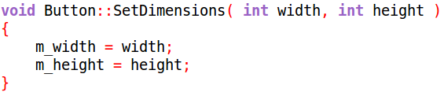
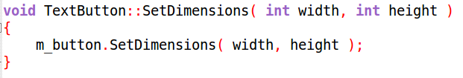
Is-A, Has-A
By making Button and Label members of the TextButton class instead of parents of it, we have nicely compartmentalized the “Button” functionality and “Label” functionality within the
m_button and m_label objects.
We are adding another layer to the object design.

Slide 35
Is-A, Has-A
Label
text
Button
width, height
TextButtonB
Label
Button
TextButtonA
Label
text
Button
width, height
There are arguments to be made for designing your objects either way,
so ultimately it is up to you.
Read other peoples' opinions, consider them, figure out what works for you.

Slide 36

That was a lot to cover!
You don't have to be a master of all these topics right now – we're mostly going to focus on vanilla inheritance,
but it is good to know what is possible, so if you encounter it later, you can do more research!

Slide 37
Let's work on an example of using inheritance.
Remember that there is also sample code for each of these topics in the course repository!

